Slide 1
Day 6: introduction to google earth engine (GEE) and github
Takaaki Masaki
Revocatus Paul

Slide 2
Today’s Agenda
Introduction to Google Earth Engine
Introduction to GitHub

Slide 3
Introduction to Google Earth Engine

Slide 4
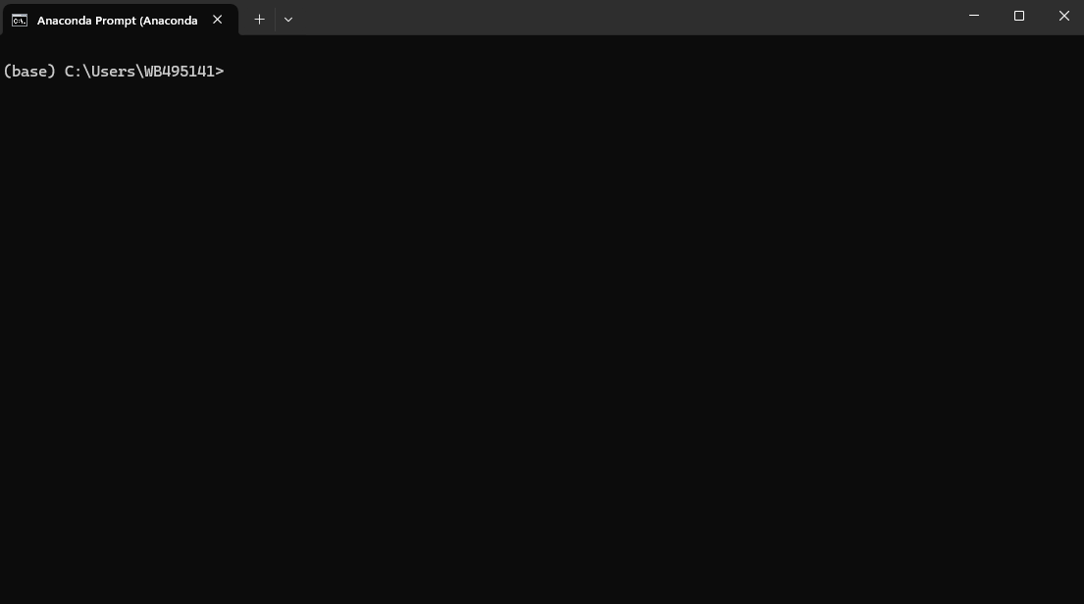
Get Python and geemap Library
To use GEE through Python, you first need to install Anaconda, Python, and geemap package
After Anaconda is stalled, go to Anaconda Prompt, which will open a new window like below. You can type in “Anaconda Prompt” in your Search bar and it should appear.
Notes:
For details on installation process, see https://www.cse.unsw.edu.au/~en1811/resources/getting-started/install-anaconda.html.

Slide 5
Get Python and geemap Library
Copy and paste the following commands into the prompt. PLEASE NOTE THAT YOU SHOULD COPY AND PASTE LINE BY LINE:
conda create -n gee python=3.11
conda activate gee
conda install geemap -c conda-forge
pip install --upgrade jupyter

Slide 6
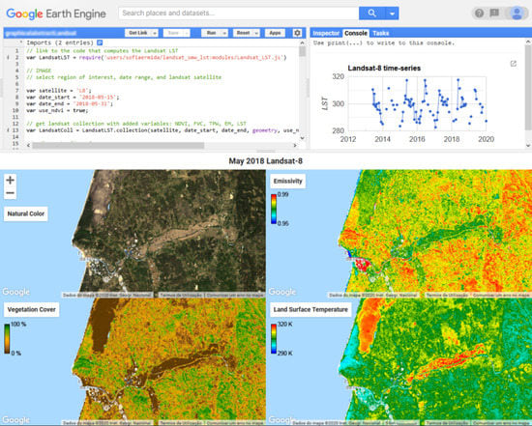

Google Earth Engine (with Python)
Google Earth Engine combines a multi-petabyte catalog of satellite imagery and geospatial datasets with planetary-scale analysis capabilities.
This segment of the training introduces you to GEE and how to work with it through geemap package in Python

Slide 7
What is GEE?
https://youtu.be/gKGOeTFHnKY

Slide 8
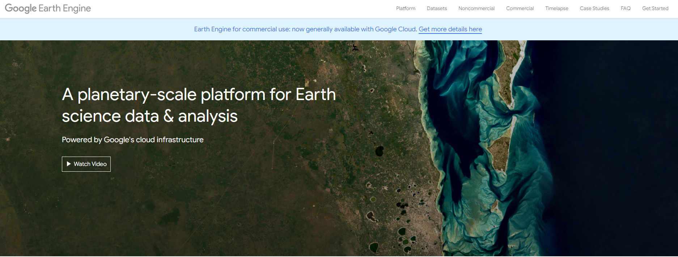
Let’s sign up for GEE
Sign in using your own Gmail on Google Chrome
Select “Get started” on the GEE website
Follow instructions to create your own GEE project

Slide 9
Setting things up
To use GEE through Python, you first need to install Anaconda, Python, and geemap library
Anaconda: a free, open-source distribution of Python and R for data science and machine learning. It includes over 250 pre-installed packages, such as SciPy, Malplotlib, Pandas, and NumPy, which are used in scientific computing.
Python: computer programming language often used to build websites and software, automate tasks, and conduct data analysis
geemap package: Python package for interactive geospatial analysis and visualization with Google Earth Engine (GEE)
Notes:
For details on installation process, see https://www.cse.unsw.edu.au/~en1811/resources/getting-started/install-anaconda.html.

Slide 10
Get Python and geemap Library
Type in the following in Anaconda Prompt:
cd “**path**“
jupyter notebook
**This path should be where your .ipynb code exists.
Jupyter Notebook: server-client application that allows editing and running notebook documents via a web browser
This will take you to a web browser where you can write scripts to run analysis in Python (or other programming languages)

Slide 11
Example: Downloading NDVI data and computing zonal statistics through GEE
6-demo.ipynb
Notes:
https://book.geemap.org/chapters/11_applications.html

Slide 12
Introduction to GitHub

Slide 13
Reproducibility – a crisis
The ability to duplicate the results of a prior study using the same results of a prior study using the same materials and procedures as were used by the original investigator – Bollen et al (2015)
Most researchers, at one point, have been unable to reproduce their own results
This happens quite often at our institution as well
How many of us have run our own programs and get different results?
How many of us have shared a project with a colleague and she gets different results? Or a colleague shares a project with you and you can’t reproduce their published results?

Slide 14
Reproducibility requires planning
Reproducibility can only be achieved if you have the following ingredients in place:
The same software is used
The same programs are used – e.g. do-files and ados
The same data is used
When things go right no one notices, but when they don’t it’s a different story.
Today we will go over how to set things up so you can achieve this with less pain

Slide 15
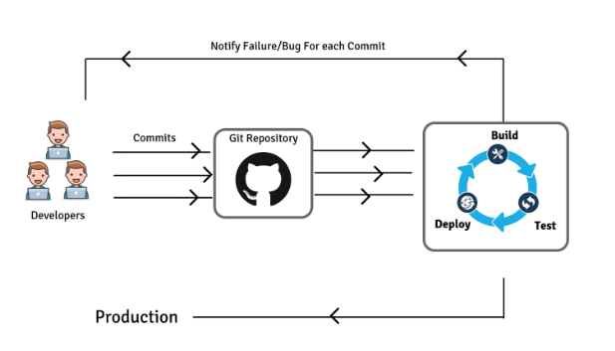
What are Git and Github?
Git is a developer application that allows for version control, allowing you to:
Revert files or the whole project to an earlier state;
Compare changes over time;
See who modified what;
Control modifications by collaborators by permission of admin/owners.
GitHub is a repository hosting service for Git, providing a web-based graphical interface that works on top of Git. It can also be treated as a social platform to share knowledge and work or provide access control and several collaboration features.

Slide 16
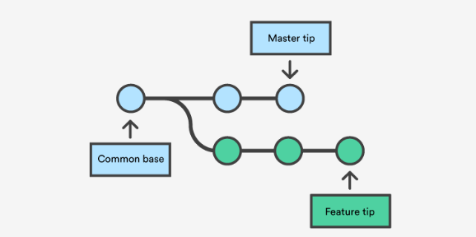
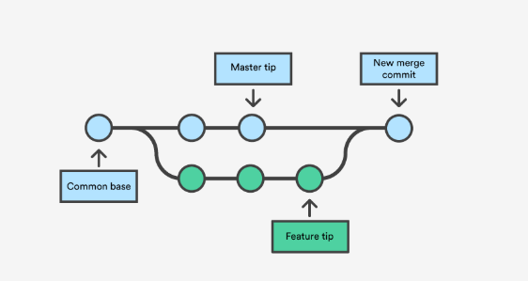
Workflow through github
Create a "repository" (project)
Fork or clone the repository to your local machine
Fork: copy without affecting the original
Clone: copy with intention to contribute to making changes to the original
Add a file to your local repo and "commit" (save) the changes
Create a "branch" (version), make a change, commit the change
Open a "pull request" (propose changes to the master branch) (Use Case 1)
["Merge" your branch to the master branch] (Use Case 2)

Slide 17
Setting up github and github desktop
Create your own GitHub account here.
You can use your own personal email or work email to sign up.
Please use Google Chrome, Firefox, or Safari as GitHub does not work on Internet Explorer.
Download GitHub Desktop here
GitHub Desktop is a Graphical User Interface (GUI) that allows you to work efficiently with GitHub repositories and implement various features (e.g., push, pull, branch, merge)
Please note that there are other GUIs available like GitKraken, SourceTree, among others. Check to see which one best fits your needs.

Slide 18
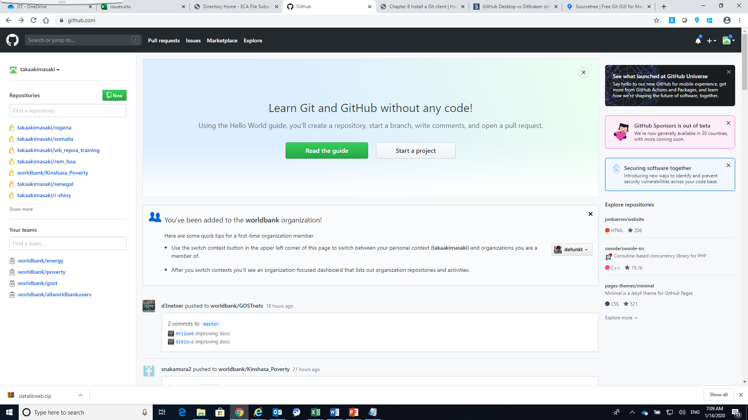
Create a repository
Go to your GitHub page
Create a new repository by clicking on
Set a repository name
You have the option of making the repository public or private
If set private, no one except for your collaborators can see what’s in the repository. But then, there is a limit on the number of collaborators (up to 3) you can have for private repositories.
If set public, all the items in the repository will be made public. There is no limit on the number of collaborators for public repositories.

Slide 19
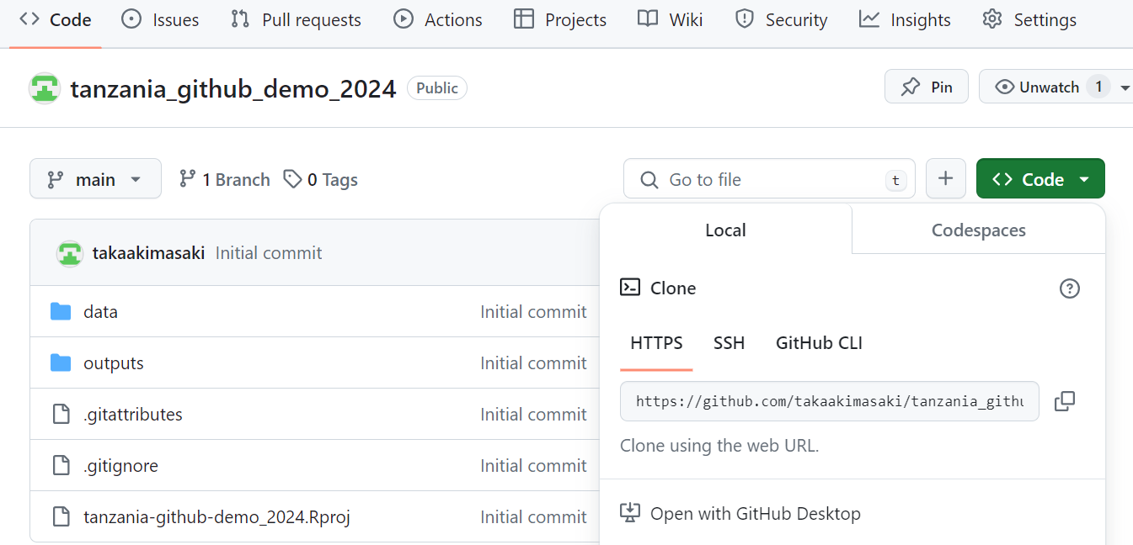
Clone the repository to your local machine
Open GitHub Desktop on your laptop and sign in
Copy (or clone) a repository to your local machine by clicking on “Code”
Select “Open with GitHub Desktop”

Slide 20
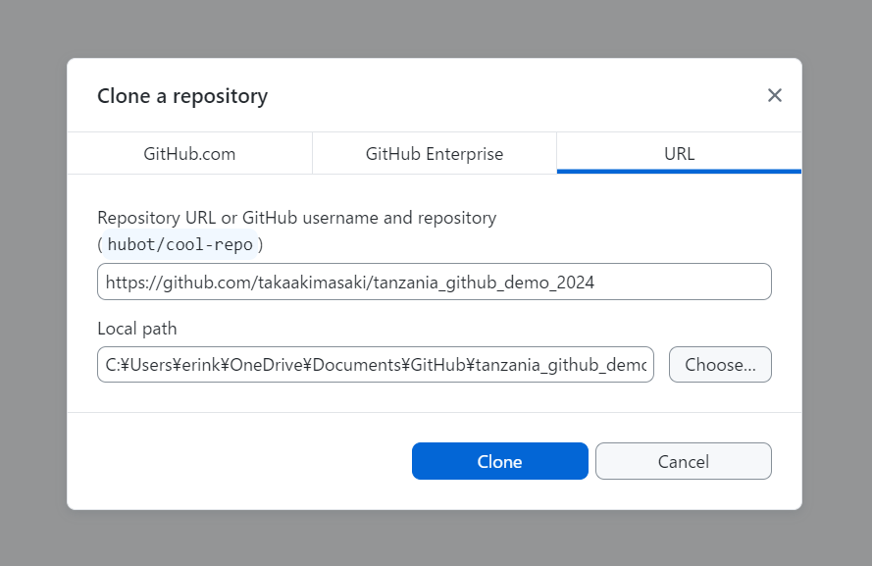
Copy (or clone) the repository to your local machine
GitHub Desktop then asks you to set a local path where a copy of the repository will be saved on your local computer
By default, a cloned repository will be saved in C:\Users\XXX\Documents\GitHub
Click on Clone

Slide 21
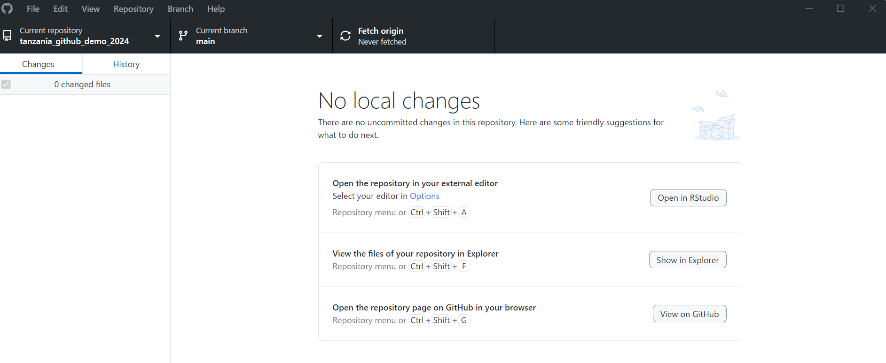
Copy (or clone) the repository to your local machine
Now make sure that you see “tanzania_github_demo_2024” under Current repository

Slide 22
Copy (or clone) the repository to your local machine
Now make sure that you see “tanzania_github_demo_2024” under Current repository
In my case, I also see a new local copy of tanzania_github_demo_2024 folder in Documents/GitHub folder.

Slide 23
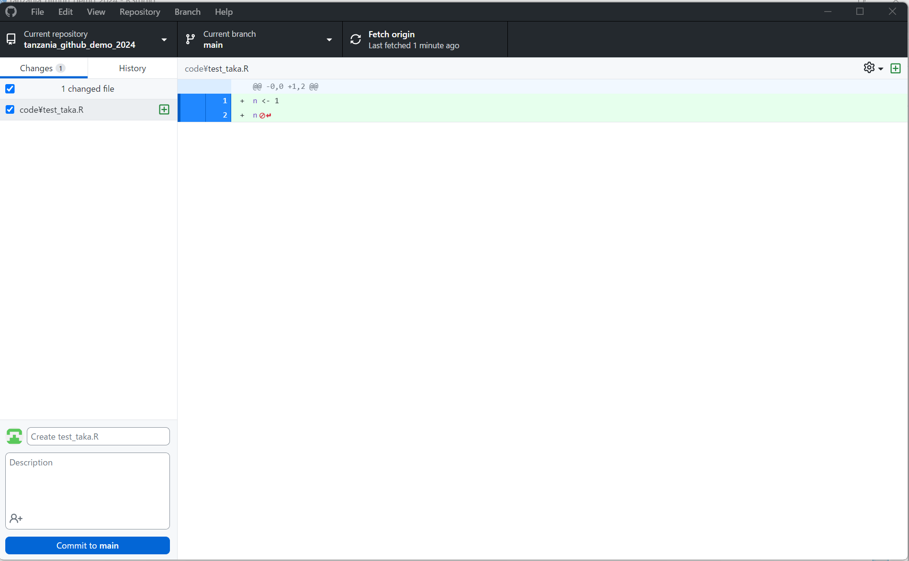
Make changes
Write a new script and save it in code folder (let’s call it test_taka.R)
You will see changes made in GitHub Desktop

Slide 24
Make changes
Write a new script and save it in code folder (let’s call it test_taka.R)
You will see changes made in GitHub Desktop
Once you finish making changes, you press “Commit to main”

Slide 25
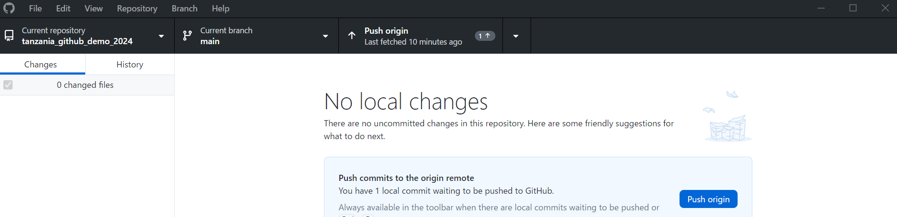
Make changes
Write a new script and save it in code folder (let’s call it test_taka.R)
You will see changes made in GitHub Desktop
Once you finish making changes, you press “Commit to main”
Note that all the changes you made so far are not yet reflected in the GitHub page online
Press “Push origin” to reflect the changes in the GitHub page online

Slide 26
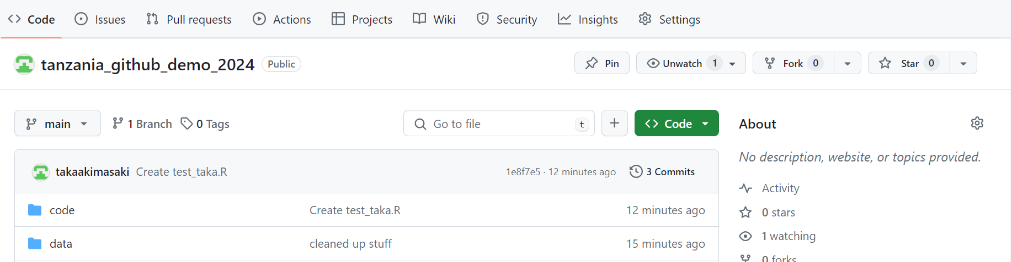
Make changes
Write a new script and save it in code folder (let’s call it test_taka.R)
You will see changes made in GitHub Desktop
Once you finish making changes, you press “Commit to main”
Note that all the changes you made so far are not yet reflected in the GitHub page online
Press “Push origin” to reflect the changes in the GitHub page online
You now see the change reflected on the page

Slide 27
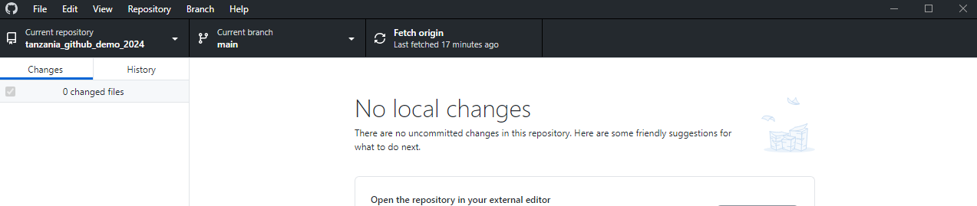
Pull changes
You can now pull changes made by your colleagues by pressing “Fetch origin”

Slide 28
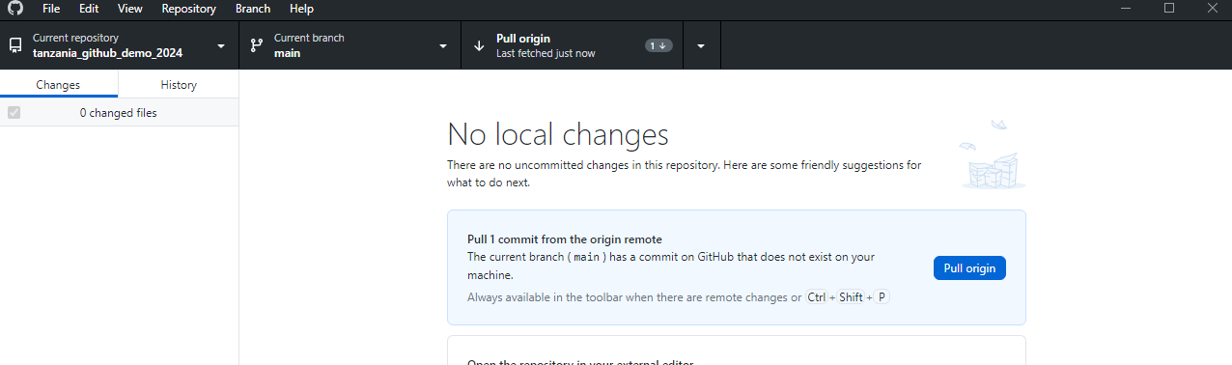
Pull changes
You can now pull changes made by your colleagues by pressing “Fetch origin”
Now “Pull origin” to reflect the changes available in the GitHub online page in your own local computer

Slide 29
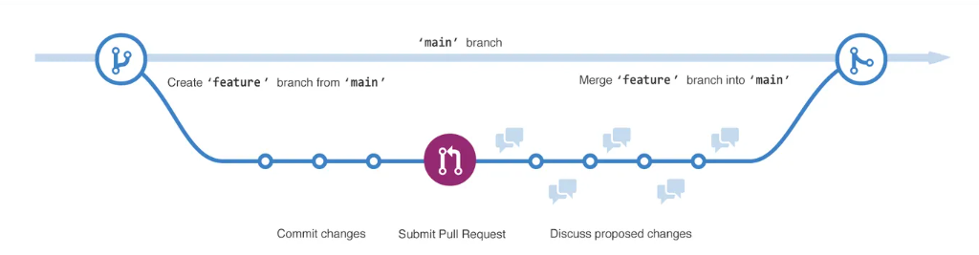
Branch and pull requests
Branching lets you have different versions of a repository at one time.
By default, your repository has one branch named main that is considered to be the definitive branch. You can create additional branches off of main in your repository.
Branching is helpful when you want to add new features to a project without changing the main source of code. You can use branches to experiment and make edits before committing them to main.

Slide 30
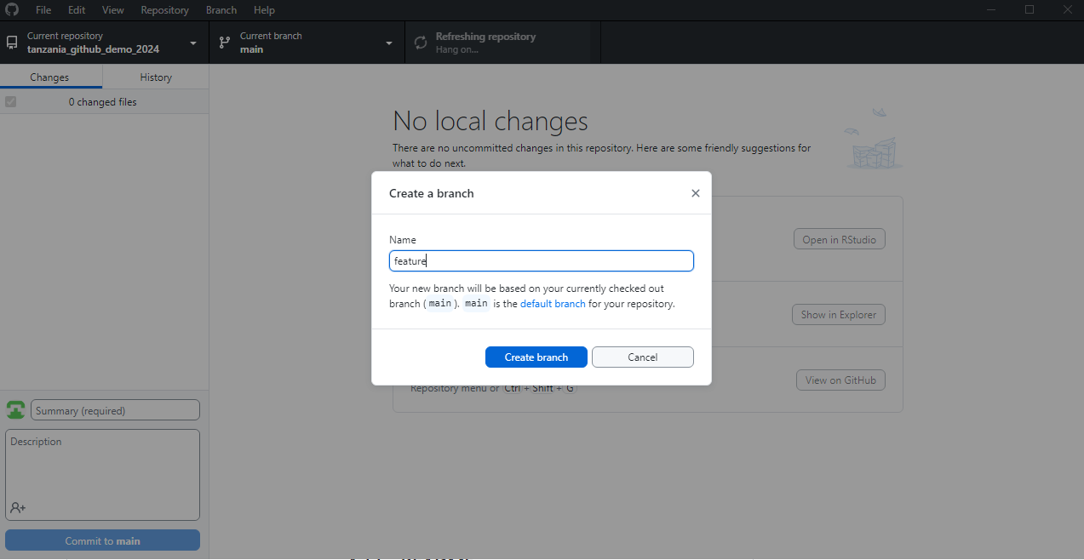
Branch and pull requests
On GitHub Desktop, you can go to Branch > New branch
Name your new branch (here I am calling it feature)

Slide 31
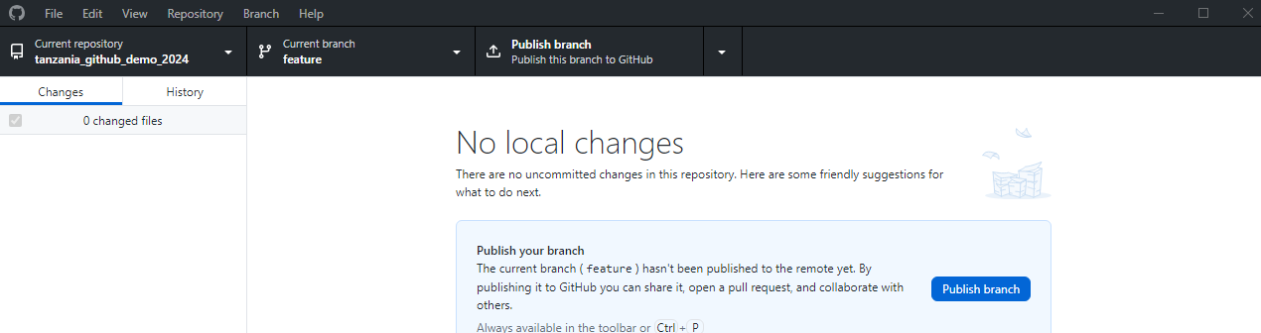
Branch and pull requests
On GitHub Desktop, you can go to Branch > New branch
Name your new branch (here I am calling it feature)
Notice that now your current branch is feature
Any change you make in this branch does not affect the main branch
Once you finish making changes, you may merge those changes to the main branch (if you want to)

Slide 32
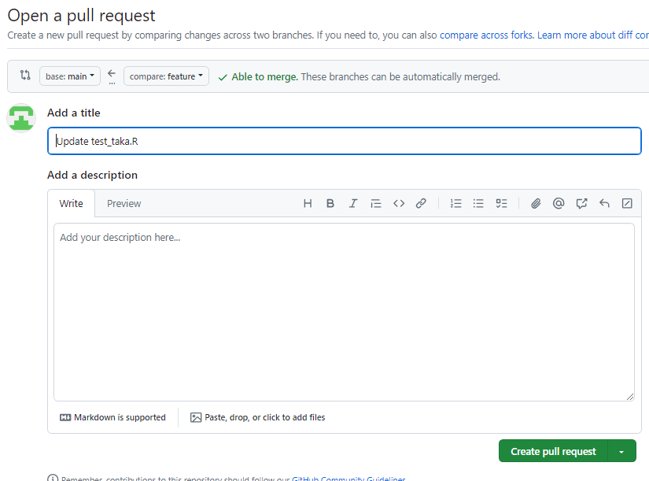
Branch and pull requests
On GitHub Desktop, you can go to Branch > New branch
Name your new branch (here I am calling it feature)
Notice that now your current branch is feature
Any change you make in this branch does not affect the main branch
Once you finish making changes, you may merge those changes to the main branch (if you want to)
You can first “Publish your branch”
Once feature branch is published, you can click on “Compare and pull request” and click on “Create pull request” to make a request for this branch to be merged with the main branch

Slide 33
GROUP STUDY PRESENTATION PREPARATION

